Slide 1
SNAKES AND LADDER
By:
Wazzah Zaidi 21L-5168
Raffay Ahmed 21I-0877
Ayyad Asif 21L-7520

Slide 2
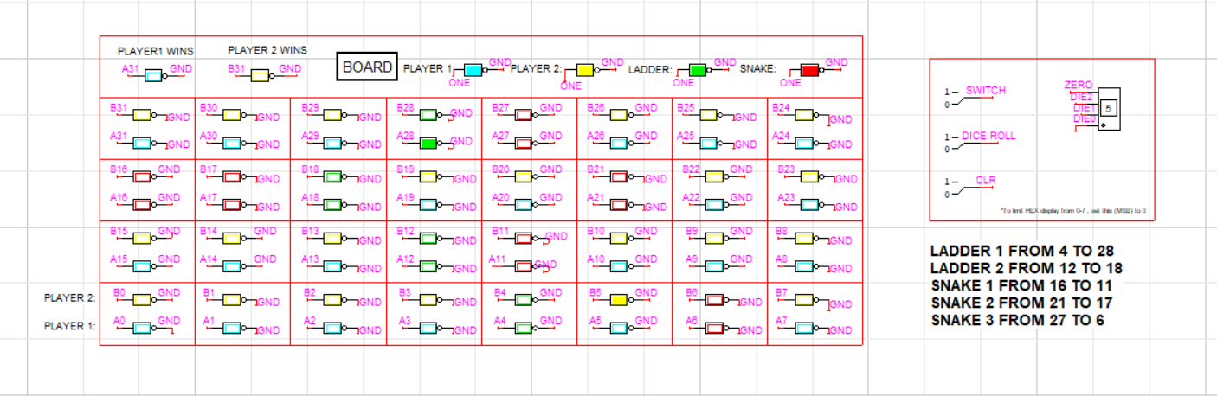
BOARD
32 LED for each player
Player 1 -> CYAN
Player 2 -> YELLOW
Switch to change between player 1 and player 2
Dice roll to choose a number
Clear to reset the game
Hex display with MSB bit = 0

Slide 3
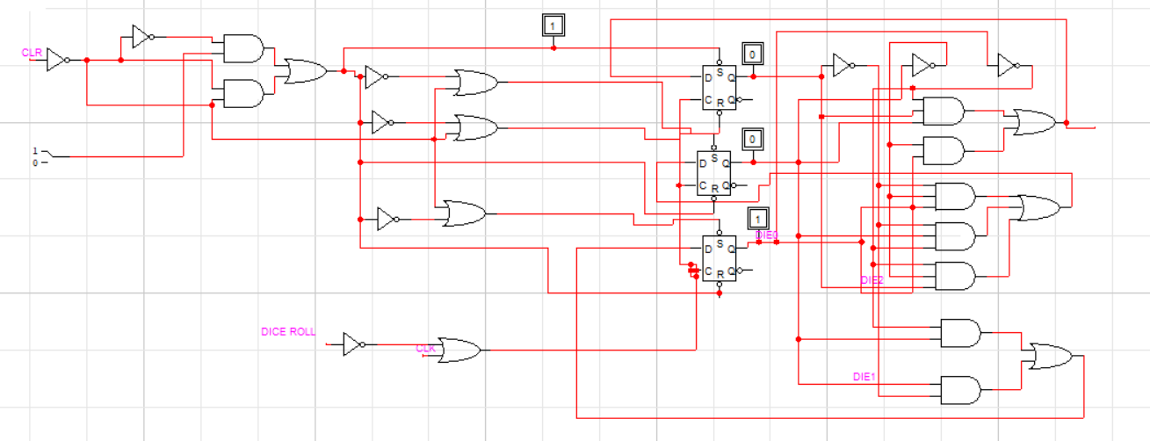
DICE
3-bit counter to get number from 1-6

Slide 4
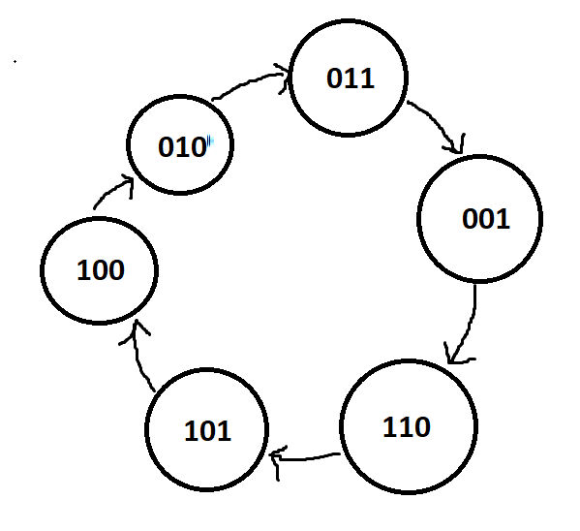
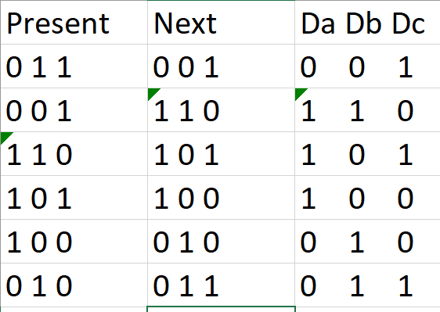
State Table and State Diagram
3
1
6
5
4
2

Slide 5
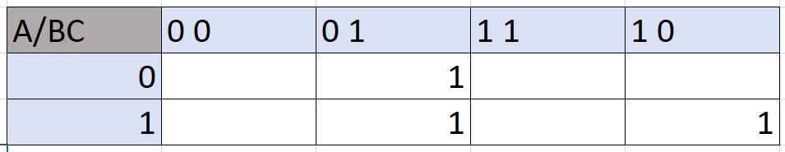
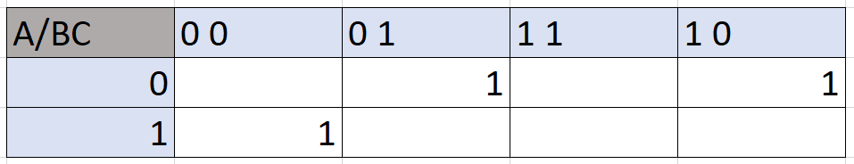
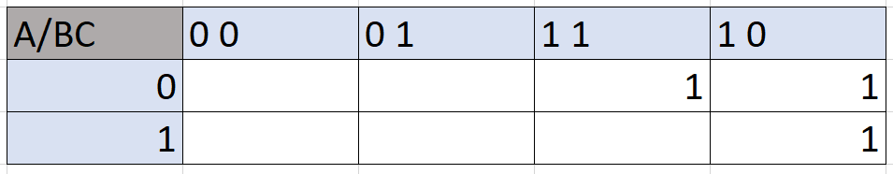
Equations for Da, Db, Dc
Da=B’C+ABC’
Db=A’B’C+AB’C’+A’BC’
Dc=A’B+BC’

Slide 6
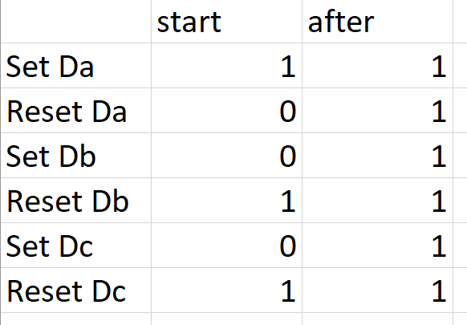
Set and Reset
We use a 2 x 1 mux to select whether to give the values in start column(all connected to CLR switch by using logic) or whether to give values from the last column(which is basically logic 1).

Slide 7
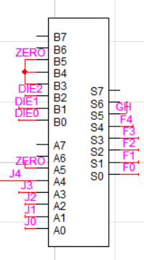
ADDER
Adds the dice value to the value present in register to generate new value

Slide 8
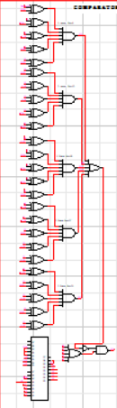
COMPARATOR
Compares the generated value from adder to the position at:
Ladder 1 at 4
Ladder 2 at 12
Snake 1 at 16
Snake 2 at 21
Snake 3 at 27
Design:
XNOR gate for equal to and used with hard inputs for each position
5 XNOR gates for 5 bits
Each output goes into an encoder

Slide 9
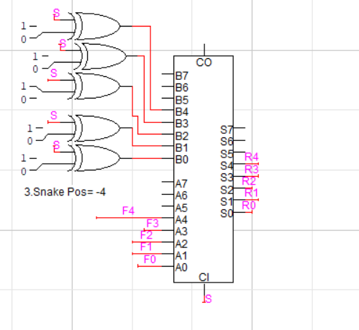
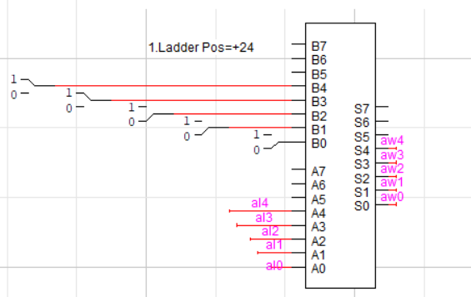
SNAKES AND LADDER
Snake:
8-bit subtractor used with hard inputs different for three snakes
Adder:
8-bit adder used with hard inputs different for two ladders

Slide 10
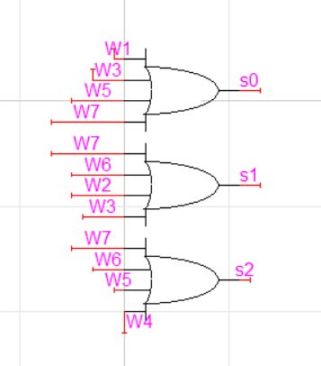
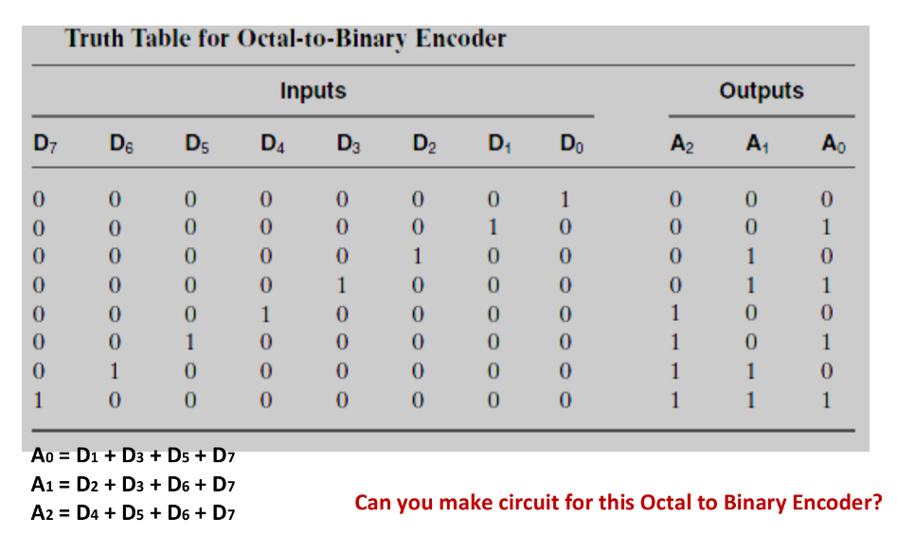
ENCODER
It used to generate selection lines for the Mux to decide which one of the 5 (snake or ladder) was enabled and the corresponding binary value of that thing is produced which is used by mux to decide therefore what binary value to pass on.
Input comes from comparator
Design:
OR gates used and if only one bit is 1 that specific selection line is used

Slide 11
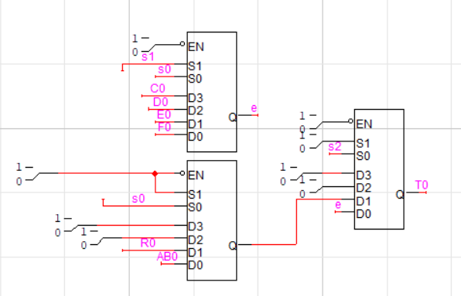
6 to 1 MUX
Selection lines from the encoders are used
4 to 1 MUX used to create 6 to 1 MUX
5 MUXs used for 5 bits for each player
Design:
4 to 1 MUX used as 2 to 1 MUX by hard inputs to 0
One 4 to one MUX and two 2 to 1 MUX used to create 6 to 1 MUX

Slide 12
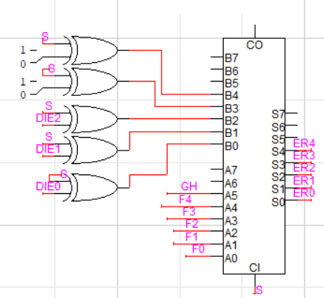
BIT CHECKER
This is used to check if a move made in the last row is valid or not.
If it is not valid, then that addition is negated by a subtraction, leading to the player staying in the same position.
This is a subtractor

Slide 13
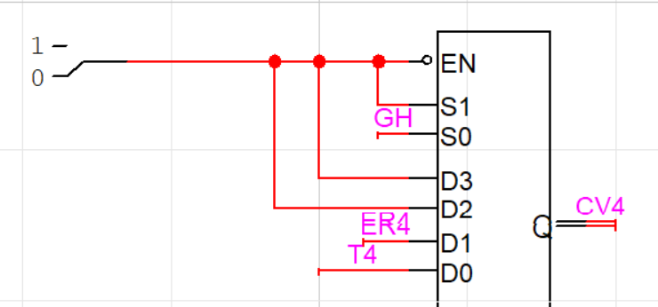
2 to 1 MUX
One selection line is the bit (GH) from the initial adder which checks if the move is possible or not
Output goes into the register
Design:
4 to 1 MUX used as 2 to 1 MUX by hard inputs to 0

Slide 14
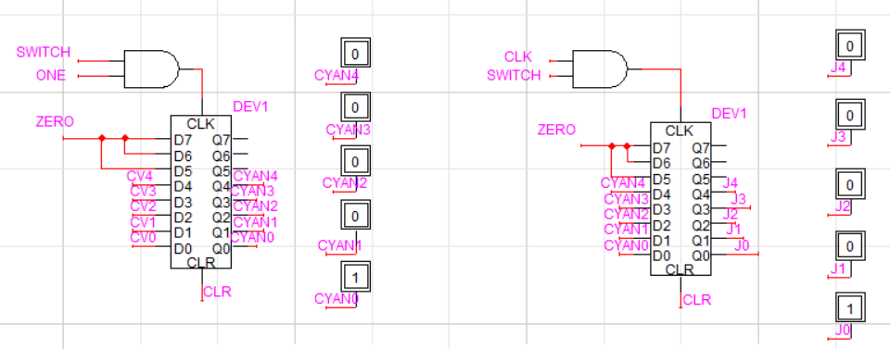
REGISTERS
One register is used to store the previous value i.e value from the last turn
Another register to store the current value

Slide 15
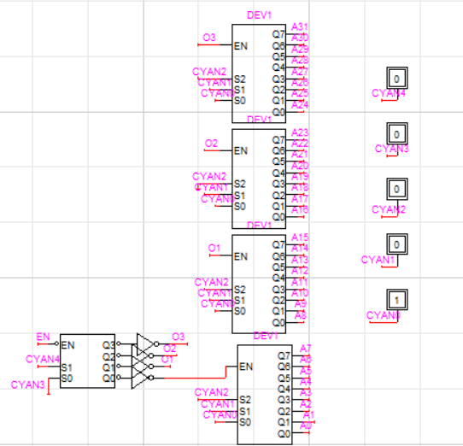
DECODER
Decoder is used to select corresponding LED
Decimal equivalent of binary digit
5 x 32 decoder used
Design:
One 2 x 4 decoder and four 3 x 8 decoder used

